Slide 1


Welcome to
PawChat
PawChat is an App that caters for all dogs. On this App all dogs will be exposed to multiple features on this App let’s not waste any more time I hope you are eager to see what’s adventurous features lies ahead.

Slide 2
My User Story
User | Type | User Story
Mobile/Tablet & Laptop Users | Registration | As a user you are required to register by fill out a application using a email, password and confirming your password. Once you are through completing your application you will receive a confirmation email The user can upload a profile photo and add their name to their account. You can login into your application by entering your email and password You can reset your password if you have forgotten You can click remind me to keep you logged in As a user you are able to view your personal information As the user you can edit your profile photo As the user you can edit your email address and you will receive a confirmation to your new email address
 | Login
 | My Account

Slide 3
PAWCHAT
Sign In Page
Welcome
USERNAME
Castro23
PASSWORD
*********
LOGIN

Slide 4

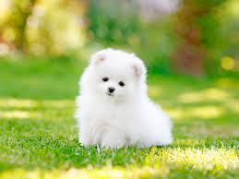
PAWCHAT
LOGOUT
Search bar
MY FEED
New post
I am really bored.
Post
Upload photo
Upload Video
What’s up!?!?
Let’s make German Shepherds Great Again
Nov 14, 2021
7 0
I so love Alaskan Huskies, They’re the cutest thing ever
Nov 14, 2021

Slide 5
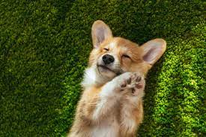
PAWCHAT
LOGOUT
COMMENTS
Kate
5 9
Let’s make German Shepherds Great Again
Nov 14, 2021
Pebbles
0 0
Nov 14, 2021
Me too ☺
Castle
0 2
Great ☺
Nov 14, 2021

Slide 6
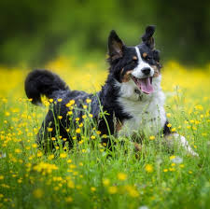
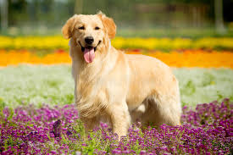
Jack
Nov 14, 2021
I am so excited to see you guys
Charles
Nov 14, 2021
Charles is typing…
New comments
I’d rather eat some snacks
Comment

Slide 7
Welcome to
Mello Hub
MELLO HUB

Slide 8
MELLO HUB
Logout
Login
Email
Castro23@gmail.com
Password
**********
Login

Slide 9
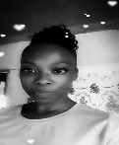





MELLO HUB
All Task
ASSGNEES | TASK NAME | STATUS
Kim | Prepare presentation for the app | Not complete
Nicki | Organize presentation area | Complete
Julie | Schedule attendees | Complete
Jade | Supervise equipment and set up | Pending
Kadeish | Financial Report | Complete
Nyioca | Presenter | Ready

Slide 10
MELLO HUB
Create Task
Log Out
NEW TASK
Title
Finish building widget
Description
The widget should be 6” tall and 4” wide, made out of plastic.
Assignee
Nicki
Create task

Slide 11
MELLO HUB
Julie
Task: Finish building the widget
Description:
The widget should be 6” tall and 4” wide, made out of plastic
Assignee
Julie
Complete Task
This is the task details page that only employees will see.

Slide 12
MELLO HUB
CEO
Task: Finish building the widget
Description:
The widget should be 6” tall and 4” wide, made out of plastic
Assignee
Julie
Save
Note: This is the “Task Detail” page, only the manager is able to see this section.

Slide 13

Thank you for watching my presentation I hope you enjoyed it.

